Slide 1
Multilingual Chatbot
Computer Engineering Department

Slide 2

Technical Skills
Design
Training chat-bot
Testing
Development
Team Details :
Sneh - 200390107024
Maulik - 200390107007
Prerana - 200390107028
Shivam - 200390107009
Pratik - 200390107045

Slide 3
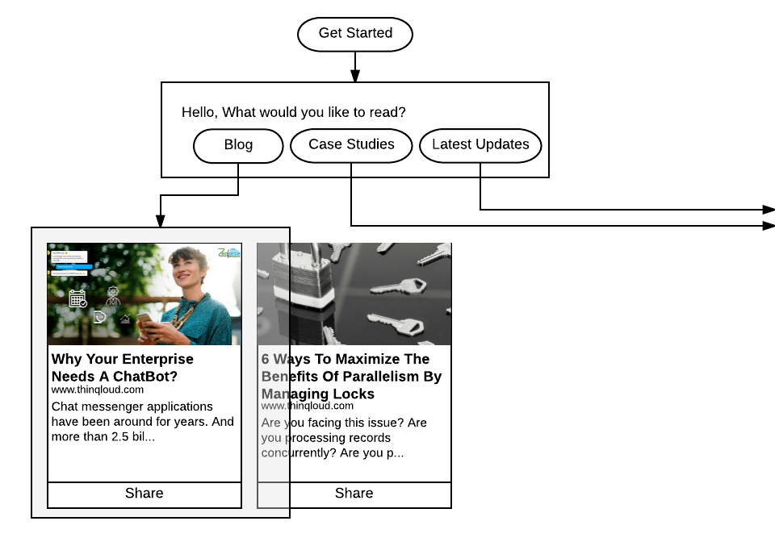
Design :-
The most crucial part of the ChatBot development is Conversation Flow .

Slide 4
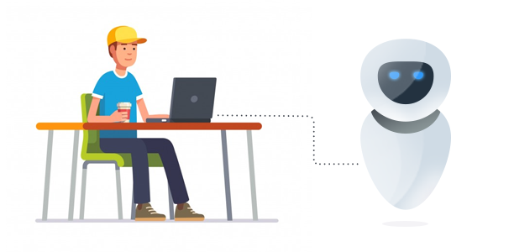
Testing :-
Conversational Flow
NLP Score
Usability & User experience
Bot Speed
Bot Accuracy
Conversation Steps
Some notes here!!

Slide 5
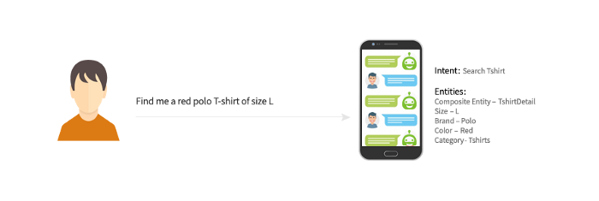
Technical Skills
Development
Data analytics
Testing and debugging Skills

Slide 6
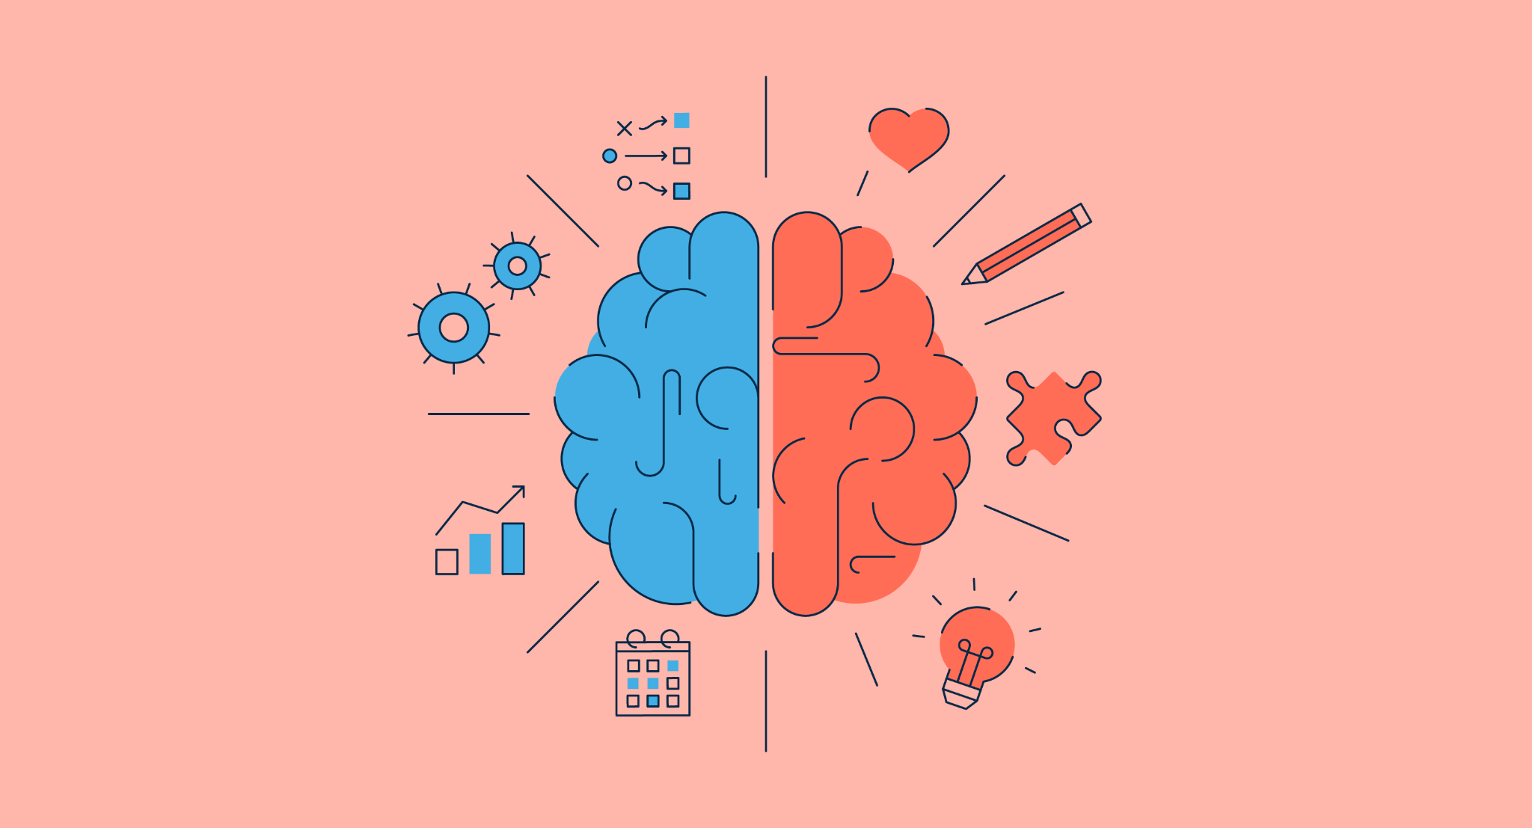
Technologies :-
A deep understanding of how
AI Processing works.
Machine Learning Processing works.
Natural Language Processing works.

Slide 7
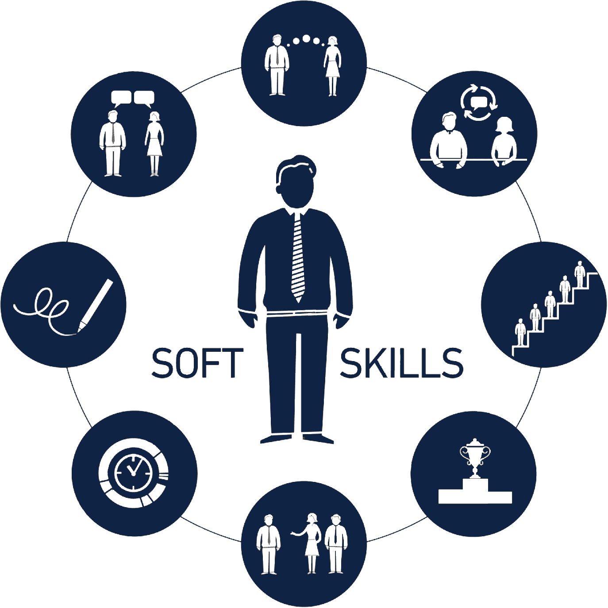
Non Technical Skills
Communication
Leadership skills
Time management
Teamwork skills
Openness to new experiences
Interpersonal Skil

Slide 8

Non Technical Skills :-
Good old-fashioned empathy
Creativity
Observations
Collaboration
Problem-solving skills
Project Management

Slide 9

Knowledge Require :-
PYthon
Nlp (Stochastic gradient descent with Nesterov accelerated gradient)
UI/UX
Anaconda (Jupyter Notebook)
IMPORTANT!

Slide 10
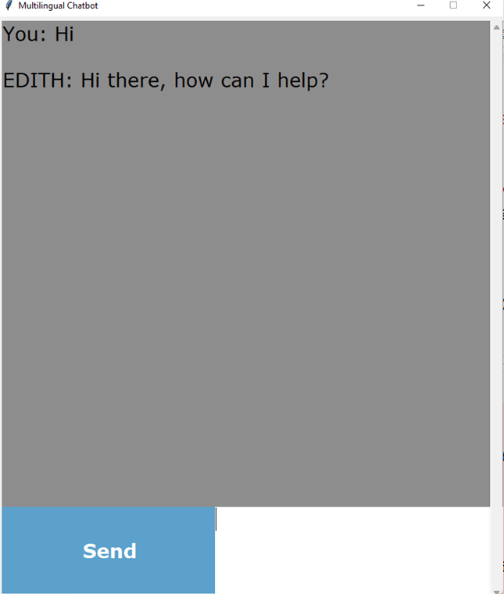
5 steps to create a chatbot in Python:-
Prototype
Import and load the data file
Preprocess data
Create training and testing data
Build the model
Predict the response

Slide 11
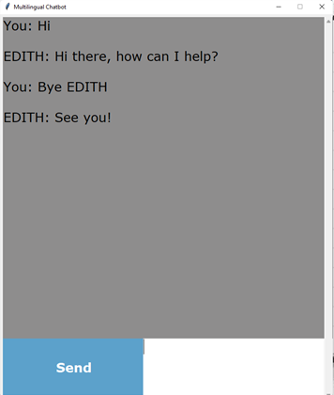
Thank you

